Slide 1

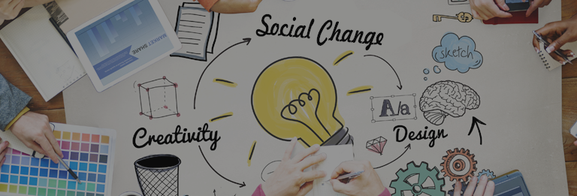
<ECO APP> (An app for environment lovers)
Theme: DESIGN FOR ENVIRONMENT <23-05-2022 - IIT (ISM) DHANBAD>
Image Source: TOI

Slide 2
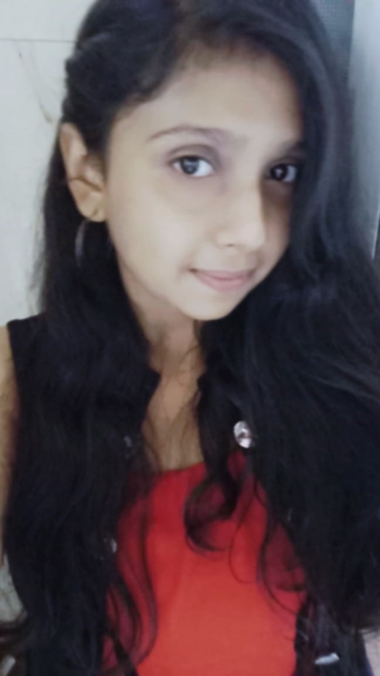
Pre-final year student in INDIAN INSTITUTE OF TECHNOLOGY (INDIAN SCHOOL OF MINES) ,DHANBAD.
Specializing in Department of Mechanical Engineering.
Always enthusiastic to learn and explore new fields.
Skilled in Coding ,Designing, Communications and Event planning.
Kadambala Meghana

Slide 3
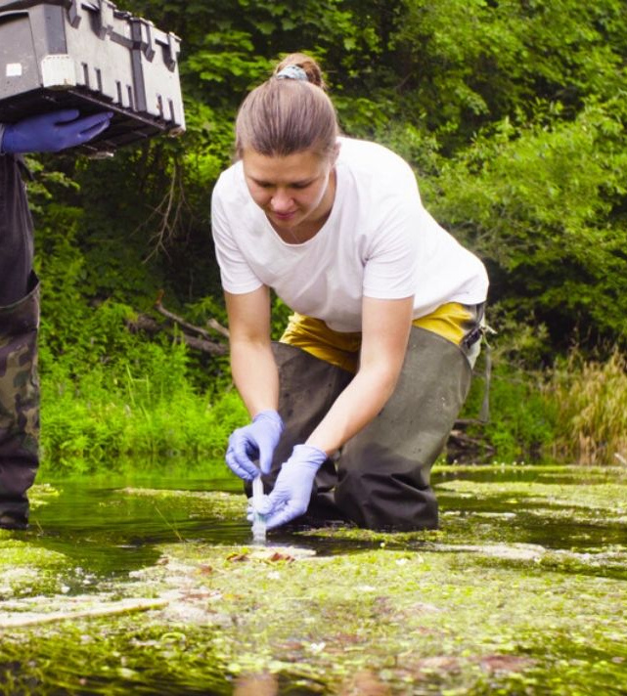
Problem Identified
Difficulty in surfing different apps to get information about environment due to busy schedule
PROBLEM DESCRIPTION
Meghana, a nature lover, who is also a software engineer wants to serve for nature and tries to learn more about the nature so that she can protect the environment. But due to her busy schedule she is unable to collect information about environment as she is not getting enough time to surf various apps and websites.
Notes:
EXAMPLES:
How might Paul, a highly proactive chief medical officer of a government ensure that the all patients, who need urgent medical help of any kind and severity are taken care timely, at scale

Slide 4
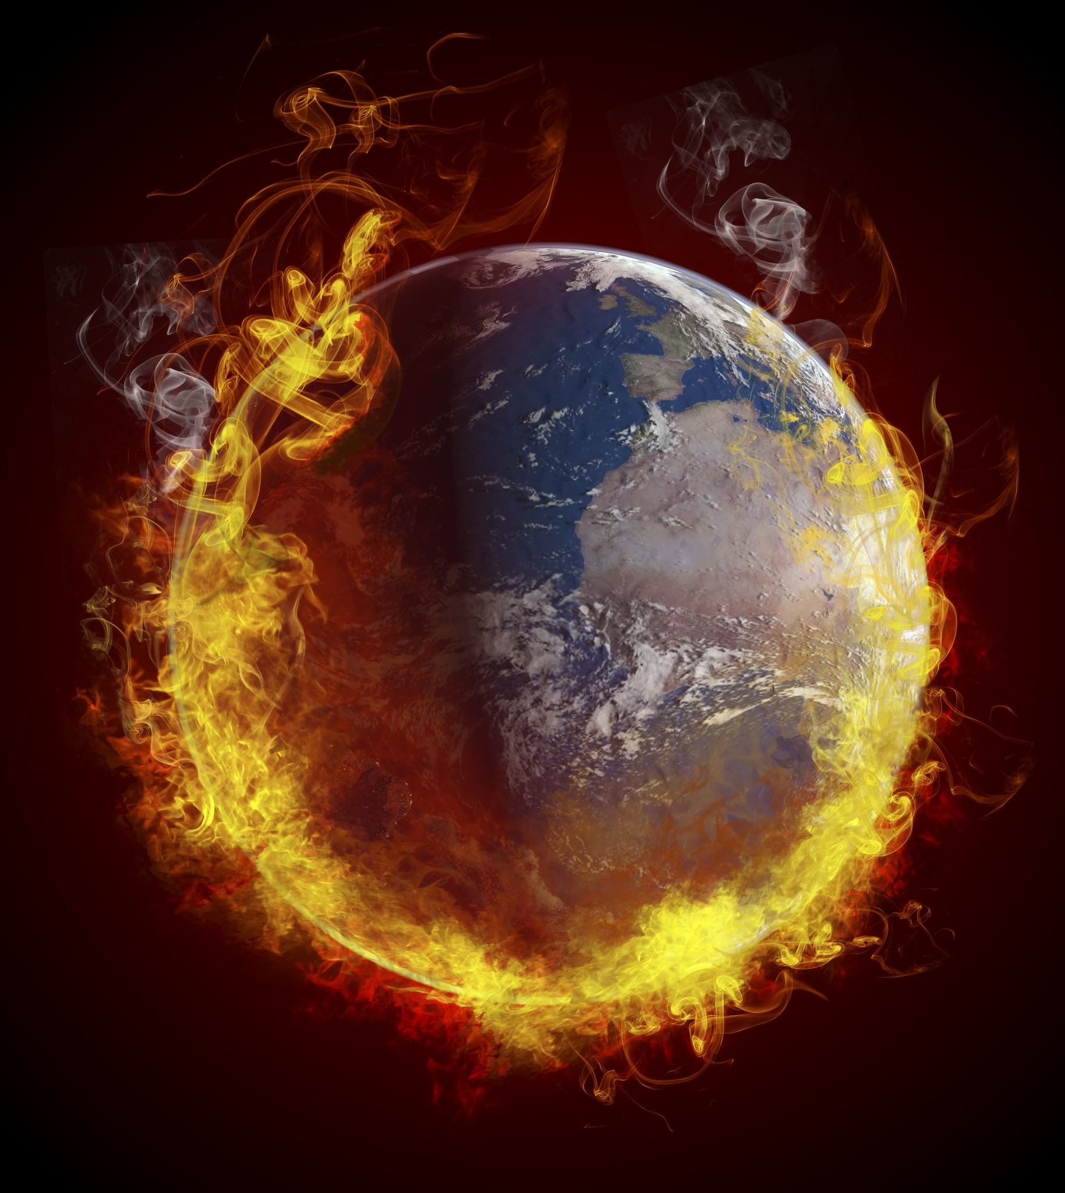
Urgency/Importance
WHY IS IT AN URGENT PROBLEM?
This is an important problem as we being responsible citizens it is our duty to protect nature, for that we need to know how much carbon are we emitting , how are the weather conditions etc.
Though carbon dioxide plays an important role in the life of the plants and helps in ensuring that the earth remains warm, increasing it in the atmosphere is what causes global warming
A quick change in the weather can lead to many underlying health conditions, including chronic diseases like heart conditions, asthma and more.
None of this would exist, though, without the abundant natural resources we inherited from the planet itself..
Notes:
PROBLEM DESCRIPTION EXAMPLE: How should hospitals and doctors take care of such patient’s appointments when RIchard is highly prone to infections? OR Any other problem WHY IS IT AN URGENT PROBLEM? EXAMPLE There are X% of patients with such similar conditions and if they are not taken care then we will be compounding the problem. Think of impact.

Slide 5
Target User Persona
USER1 : ADULT (Female)
PROFILE & DEMOGRAPHICS
Job Title: Software Engineer Gender: Male Family and Social Setting: Income: 80,ooo Education: B-Tech Environmental Engineering
FEELINGS
Worries : Concerned about nature as she is unable to check all the required details regularly due to busy life Influences: As there are different apps for monitoring , controlling and calculating different cause of environmental problems
Small Family
GOALS & VALUES
Goals: To protect the nature Motivations: To provide green, safe nature for future generations.
PAIN POINTS
Fears: Being unable to prevent environmental problems Frustrations: No proper medium for analysing and controlling problems Challenges: Need to motivate people and have thorough check of natural resources
Notes:
Persona Reference : https://www.leadwithprimitive.com/blog/buyer-persona-examples-defining-your-target-audience https://avidmode.com/blog/creating-personas-for-products-customer-service-and-marketing

Slide 6
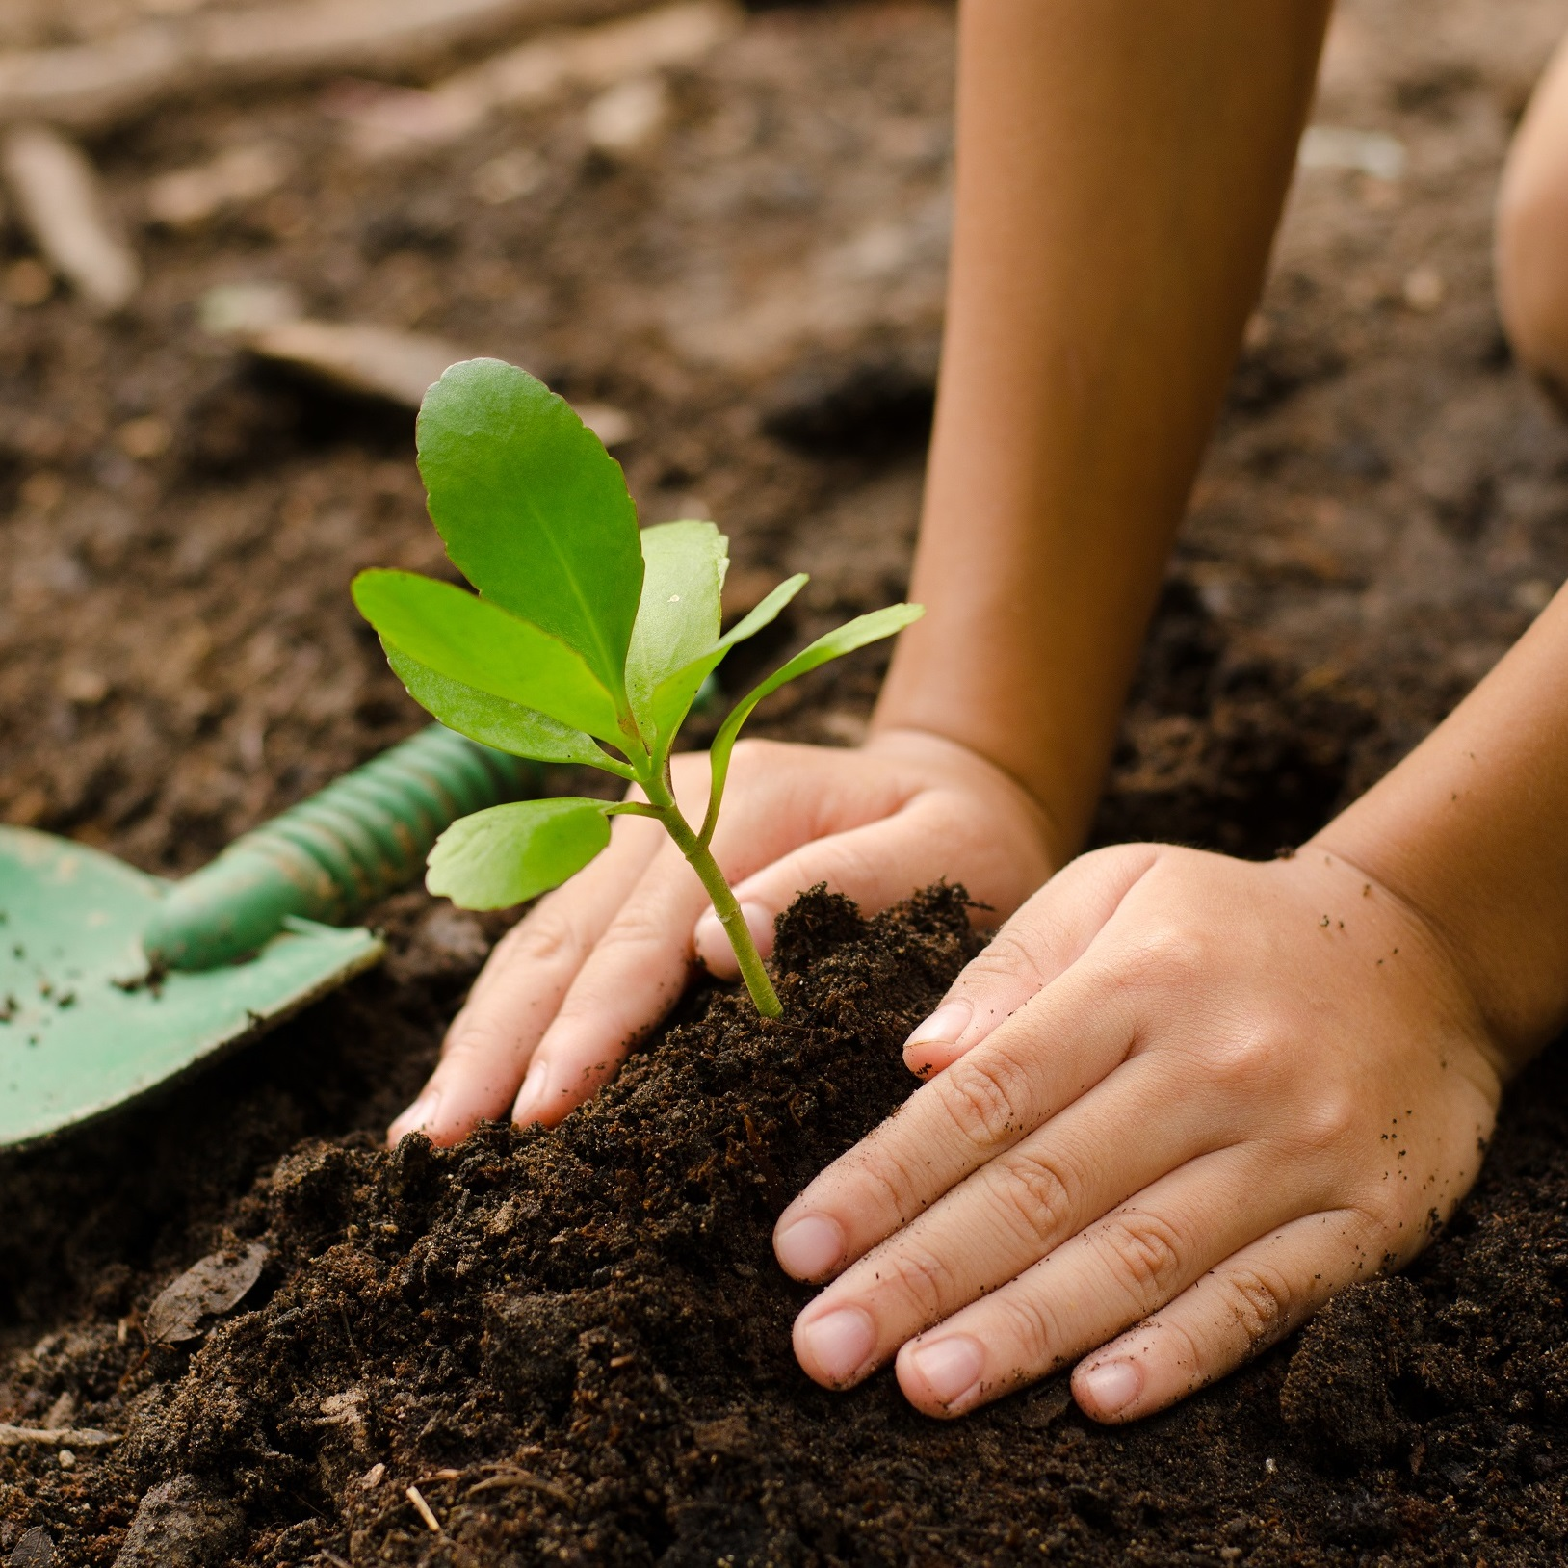
Explorations
SOLUTIONS & IDEAS
Calculation of carbon footprint so that we know how our daily habits are causing carbon emissions, so that accordingly we will manage.
Planting trees daily.
Being eco-friendly and saving natural resources..

Slide 7
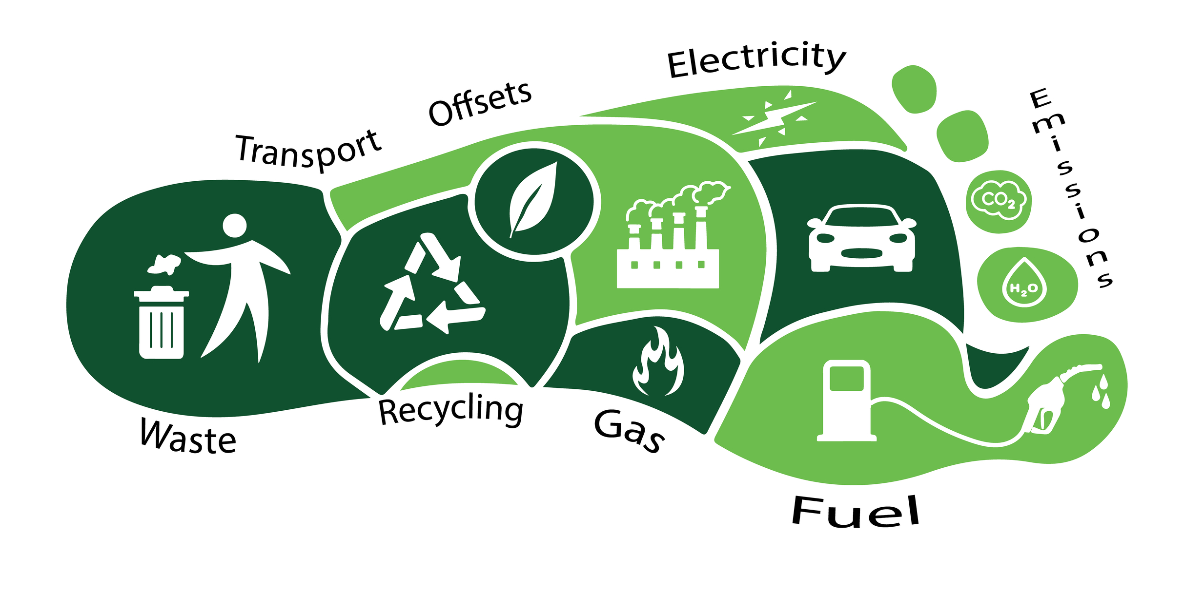
Final Solution & Innovation
HOW DOES YOUR SOLUTION ADDRESS THE PROBLEM IDENTIFIED? HOW IS IT INNOVATIVE?
I designed a app to solve this problem to extent and to help nature lovers to know what is the condition of environment.
This app shows user how much energy they are wasting/saving , how much they are responsible for carbon emissions, tells them the weather conditions etc.
It also tells information about limited resources.
It provides an option of eco-friendly shopping which has products which are recyclable.
It also provide a medium to donate money for plantation

Slide 8
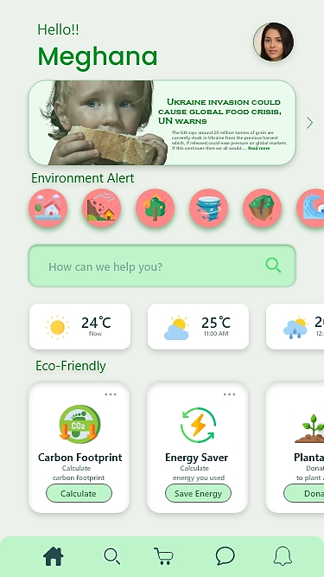
User Experience
HOW DOES THE UX OF YOUR SOLUTION LOOK LIKE?
I used Adobe XD as a medium to convey my idea in the form of an app.
This is the sample user interface of how the user who is using the app experience.
The colors and the data provided here are just for the time sake and will be modified accordingly when it comes to use.

Slide 9
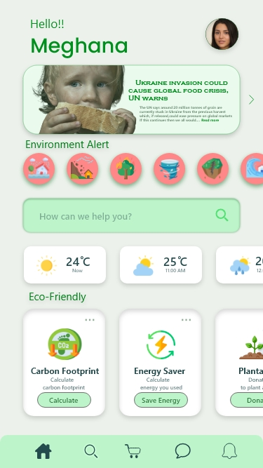
Shows us the information or news
about limited resources Daily
Gives us alerts before natural calamities or we can report about the calamities
Shows us the weather conditions
Shows us the amount of energy we saved/ wasted
Helps to calculate carbon footprint by tracking our daily actions
Medium to donate money for plantation of trees
It is a eco-friendly shopping cart which has the recycled products

Slide 10
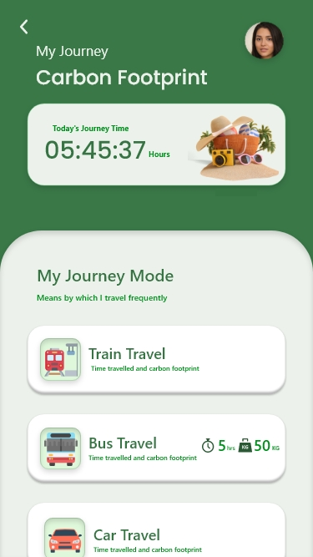
Shows us time we spent in travelling per day.
Shows us time we spent in travelling in different means of transport and also calculates the carbon footprint

Slide 11
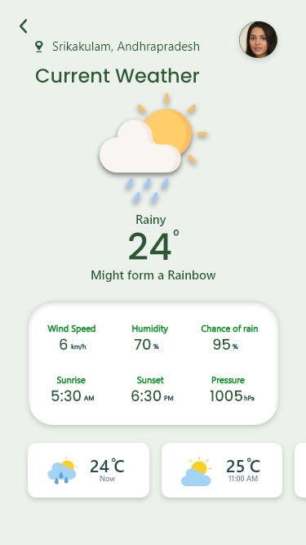
Shows us the current weather condition
Shows us the current weather statistics
Predicts the upcoming weather conditions

Slide 12
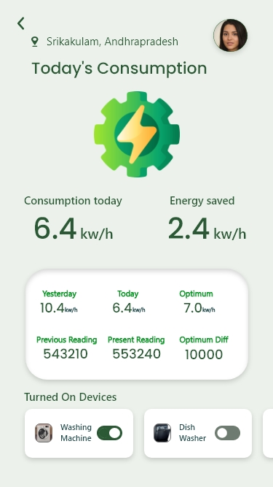
Shows us our energy consumption and energy we saved
Shows us our electricity usage statistics
Shows all the turned on devices which uses electricity

Slide 13
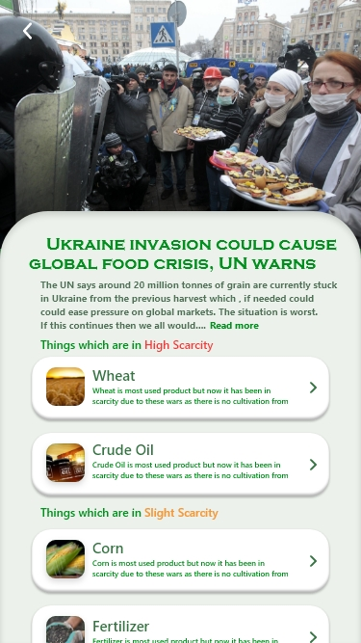
Shows us daily news on limited resources
Using the information and statistics gives us information about highly scarce resources
Using the information and statistics gives us information about slightly scarce resources

Slide 14
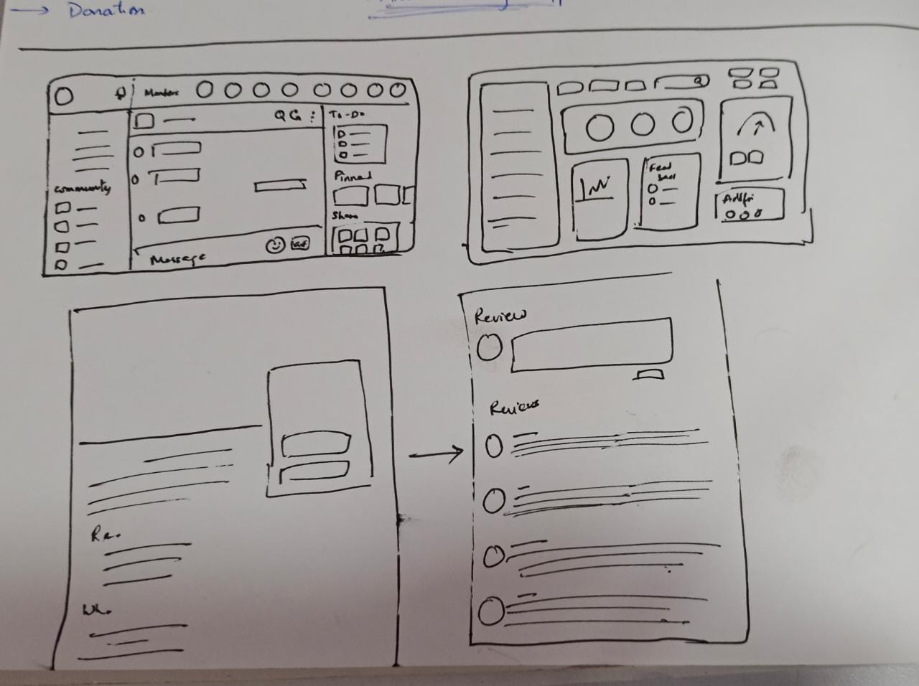
Design Process
DESIGN PROCESS FOLLOWED
Firstly, I noted down list of things required for an user so that they can get good scores.
Then drew a rough wireframe adding the requirements of the user to wireframe as shown in the figure .
Then using Adobe XD , I implemented my design by adding suitable icons which describe the specific functions.

Slide 15
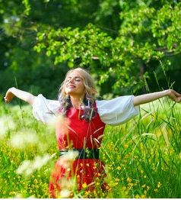

Impact on the Society
IMPACT OF YOUR SOLUTION
As my design is best suited for the users who have self-interest to protect nature. It helps them to know more abut the nature and pollution they are causing.
Daily reports and analysis makes them to take it as a challenge and will be able to reduce carbon emissions and save energy
Daily news on scarcity of resources develops a habit of saving and proper use of resources.
They can make plans accordingly with the help of weather predictions.

Slide 16
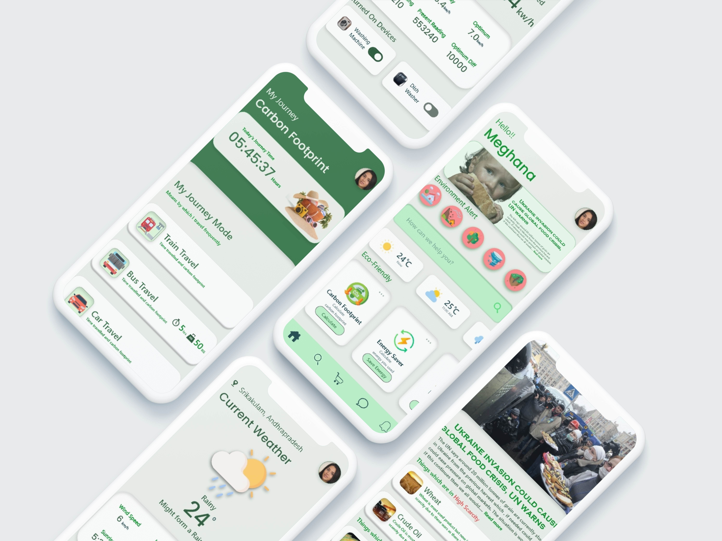

Slide 17



